Slide 1

Notes:
There is a lot here for...
devs, qa, ba and project leadership
Meant to wet your whistle.
“WHAT IS YOUR PAIN?”

Slide 2
A programmer is going out for a stroll one evening. His wife asks him to swing by the store and pick up a gallon of milk, and if they had eggs, to get a dozen. He returned with twelve gallons of milk and said "They had eggs."

Slide 3
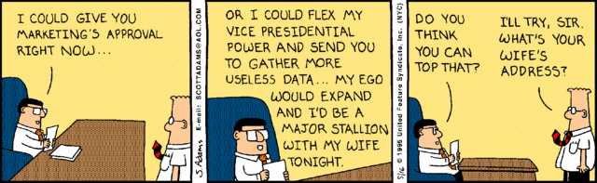
Notes:
our existences are about precise communication

Slide 4
Our existences are about precise communication...and communication is about feedback loops
Notes:
Which means feedback is important

Slide 5
Our existences are about precise communication...and communication is about feedback loops
Notes:
Which means feedback is important

Slide 6
Improving your Agility
Notes:
Which brings us to
HOW MANY TEAMS?
ALL AT DIFFERENT ADOPTION LEVELS?

Slide 7
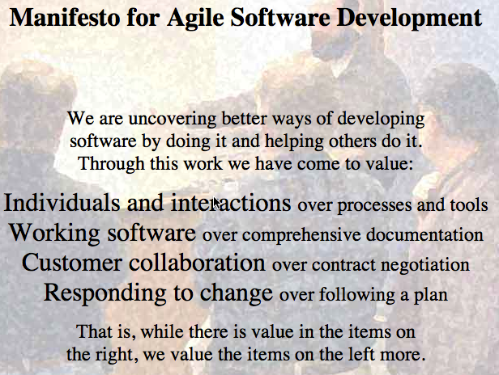
Notes:
There is not a lot about process only that process should support creating working software.
People analyze agile by checking how many of these practices you have put in place.
Already, we have lost our way.

Slide 8
We are trying to “productize” our approaches...again.
Notes:
The ceremony has become our goal

Slide 9
We are trying to “productize” our approaches...again.
Notes:
The ceremony has become our goal

Slide 10
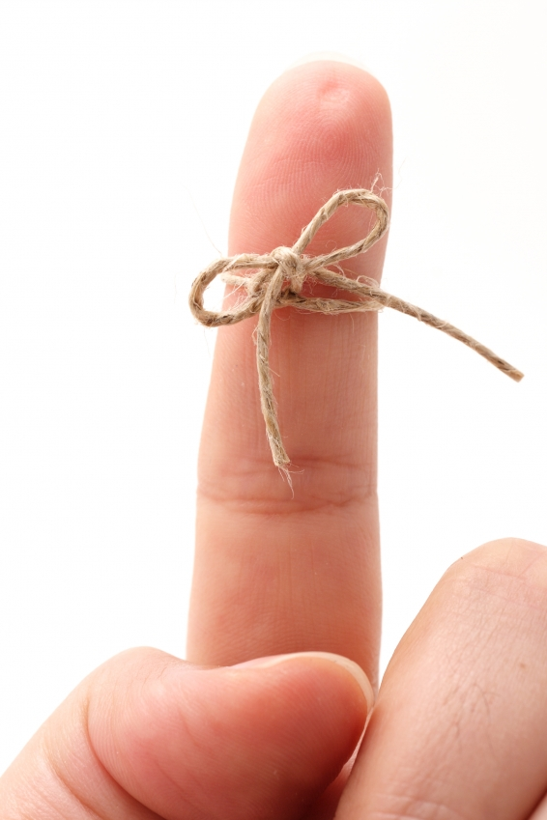
Fundamentally agile is about approaching the work in a different way.
Notes:
Not about process, not about ceremony, about delivering working software, SHORTENED FEEDBACK LOOP

Slide 11
We ARE agile
(we don’t DO Agile)
Notes:
Remind yourselves why this is a good idea. (GRANGE EXAMPLE OF FOCUSING on the ceremony)
this is the goal...to be agile. Teams start and progress at different paces

Slide 12
Revisit the “Why”
(as well as the “How”)
Notes:
Remind yourselves why this is a good idea. (GRANGE EXAMPLE OF FOCUSING on the ceremony)

Slide 13
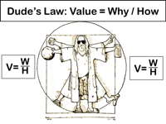
http://devjam.com/devjam/the-dude/
Notes:
David Hussman
Today we are talking about some of the process we have.

Slide 14
ATDD is a Development Practice, not a testing practice
Notes:
A regression suite is a nice by-product

Slide 15
Work from an expression of the desired behavior
examples become tests
examples elaborate requirements
tests verify requirements

Slide 16
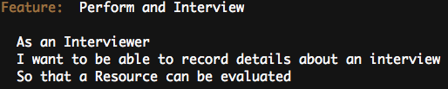
Who’s Using the System
What are they doing?
Why do they care?
Features

Slide 17
Scenarios
Features are defined by one or more scenarios
Sequence of steps thru the feature that exercises on path
Use BDD style – given-when-then
Scenario: <description>
<step 1>
…
<step 2>

Slide 18
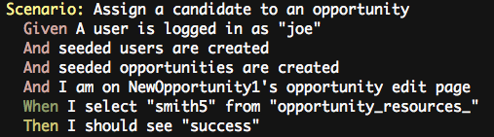
Given - Sets up preconditions, or context, for the scenario
When - The action, or behavior, that we’re focused on
Then - Checks post-conditions and verifies that the right thing happened in the When stage
Scenarios
Notes:
Ruby and .NET
They are expressive

Slide 19
Examples
Notes:
1) show bowling game
2) show modified (specification by example)
3) show good and bad authentic examples
4) write the sample feature if there is time
THE LOGIN FEATURE

Slide 20
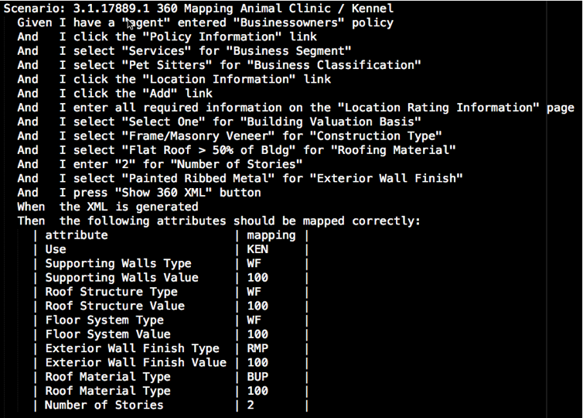

Slide 21
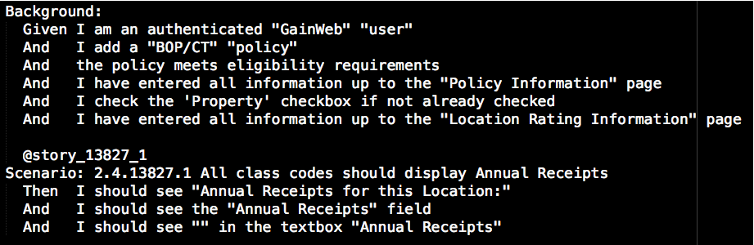

Slide 22
Acceptance Test Driven Development (ATDD) is a practice in which the whole team collaboratively discusses acceptance criteria, with examples, and then distills them into a set of concrete acceptance tests before development begins.
Notes:
Is not automation only, is not manual testing only. It is the process by which we define done (acceptance criteria) and know how to repeatedly validate.

Slide 23
Why ATDD
Implementing changes more efficiently
Shortened feedback loop
Higher product quality
Less rework
Better work alignment to priority

Slide 24
Acceptance Test Driven Development
Is not simply automated testing alone
Is not simply manual testing
But we favor automated over manual acceptance tests
Notes:
Define

Slide 25
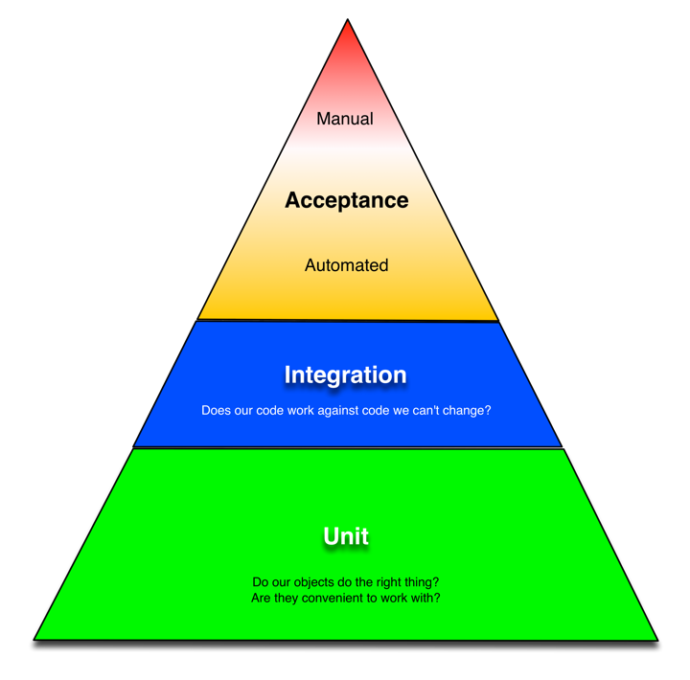
Testing Triangle
Faster
Cheaper
Notes:
First some terminology
What about the manual testers? (didn’t do a good job with this at Grange)

Slide 26
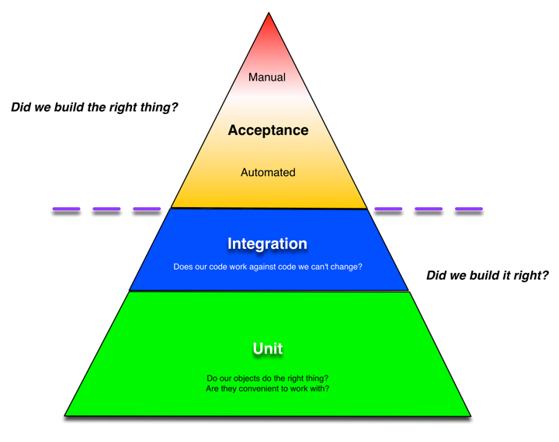

Slide 27
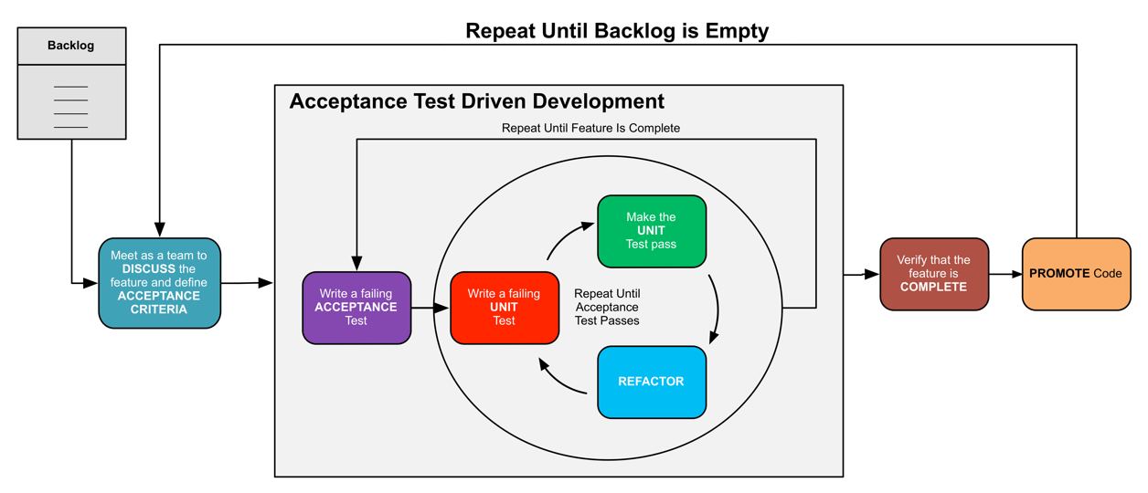
ATDD and TDD work together
Notes:
BDD is how we encode the failing ACCEPTANCE test

Slide 28
Demonstrate how BDD and ATDD work together
includes demonstration of defining the feature and then implementing the feature
This about what you are testing

Slide 29

Notes:
the testing pyramid informs the three amigos
what is the three amigos
QA has a seat at the table at design time

Slide 31
Discuss practices
automation
continuous integration
continuous deployment

Slide 32
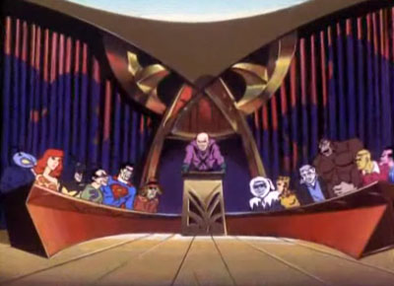
A Case Study
Legion of Doom

Slide 33
Case Study - Legion of Doom
TEAM

Slide 34
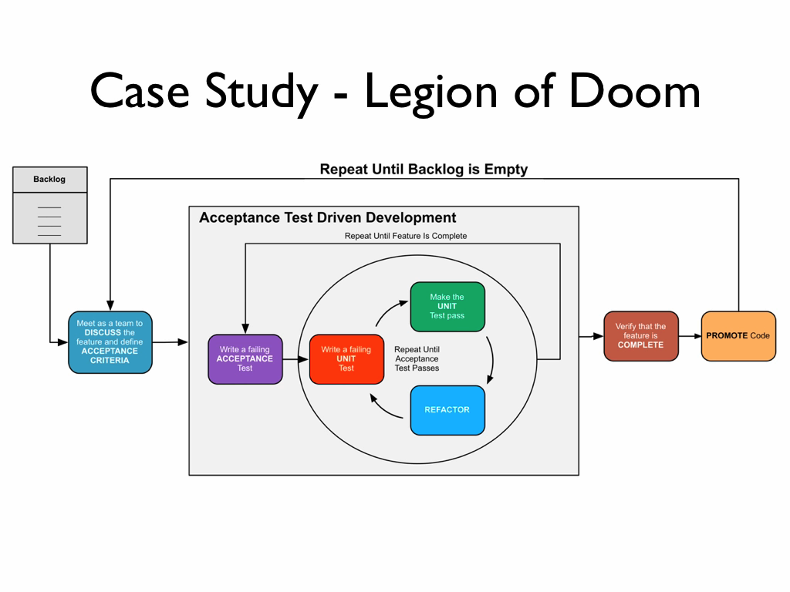

Slide 35
Case Study - Legion of Doom
Requirements written in BDD format (Given - When - Then)
Queue limits ensure only two cards in play at any particular time
Code is not committed until all tests pass

Slide 36
Q&A
For more information...
cukes.info
Gojko Adzic
  cuke4ninja.com
  Specification by Example
https://github.com/aslakhellesoy/cucumber/wiki
http://groups.google.com/group/cukes
http://www.cheezyworld.com
The Cucumber Book, Matt Wayne, Aslak Hellesøy: http://pragprog.com/book/hwcuc/the-cucumber-book
The Rspec Book, David Chelimsky: http://www.pragprog.com/titles/achbd/the-rspec-book
http://simpleprogrammer.com/2011/11/21/understanding-the-vertical-slice/
http://www.deltamatrix.com/2012-04-17-04-37-50/horizontal-and-vertical-user-stories-slicing-the-cake

Slide 37


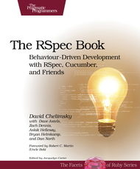
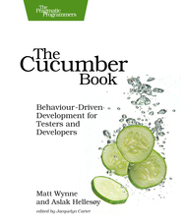
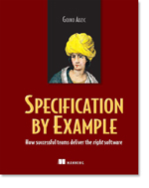
Further Reading
Growing Object-Oriented Software, Guided by Tests
Steve Freeman, Nat Pryce
Clean Code: A Handbook of Agile Software Craftsmanship
Robert C. Martin
The RSpec Book: Behaviour-Driven Development with
RSpec, Cucumber, and Friends
David Chelimsky, Dave Astels, Zach Dennis, Aslak Hellesøy,
Bryan Helmkamp, Dan North
The Cucumber Book: Behaviour-Driven Development for
Testers and Developers
Matt Wynne and Aslak Hellesøy
Specification by Example
Gojko Adzic

